Slide 1

IT TICKET ANALYSIS
A Deep Dive into IT Support Performance
BY MADDU SRUTHI GEERVANI

Slide 2
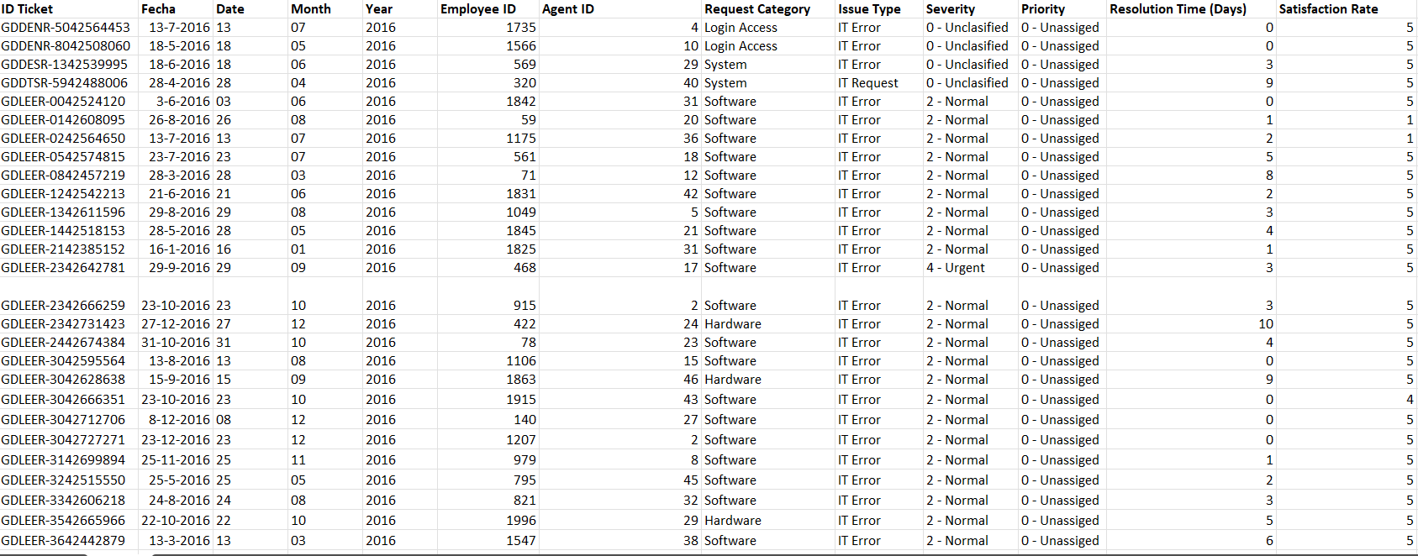
Problem Statement
The objective is to analyze the IT support ticket management system to understand the performance of IT agents, the efficiency of ticket resolution, and the satisfaction levels of employees. The analysis aims to identify high and low performers among IT agents, assess the overall effectiveness of the team, and pinpoint areas for improvement in the ticket resolution process. The ultimate goal is to make informed staffing decisions, including hiring, firing, and training, to enhance overall service quality and team performance.

Slide 3
Data overview
This analysis is based on a dataset of 97,498 IT support tickets, sourced from an internal service management system, to evaluate help desk performance and identify key trends.
The data is structured into two main files: a Tickets Sheet that tracks every detail of support requests and an IT Agents Sheet with information about the support personnel.
Key performance indicators (KPIs) for this analysis include Resolution Time, which averages 5 days, and Employee Satisfaction, which is measured on a 1-to-5 scale.
The IT help desk manages a consistent workload, handling an average of 53 new tickets each day.
Each ticket is categorized by Request Category (like Login Access or System), Issue Type, Severity, and Priority, allowing for a detailed breakdown of support needs.
By linking the ticket data with the agent data using the Agent ID, we can analyze performance metrics in relation to specific agents and agent demographics.

Slide 4
Analysis of Ticket Volume (2016-2020)
Key Insights:
The number of support tickets shows a consistent upward trend, more than doubling over the five-year period from 13,051 in 2016 to 29,088 in 2020.
This growth in workload is accelerating, with the largest single-year jump in tickets occurring between 2019 and 2020.

Slide 5
Ticket Distribution by Category
Key Insights:
Nearly 70% of all support tickets fall into just two categories: "System" (39,002 tickets) and "Login Access" (29,193 tickets).
Despite being a category, "Hardware" issues make up the smallest portion of tickets at just 10%, indicating they are less frequent but may have a different impact on resolution time.

Slide 6
Evolution of Customer Satisfaction (2016-2020)
Key Insights:
There has been a steady, positive improvement in service quality, with the average customer satisfaction score increasing from 3.98 in 2016 to a high of 4.16 in 2020.
The upward trend suggests that strategic initiatives such as agent training, process improvements have been effective in enhancing user's perception of service.

Slide 7
Analysis of Tickets by Severity Level
Key Insights:
The vast majority of support tickets, 88,656 in total, are classified with a "Normal" severity level, which constitutes the standard, day-to-day workload for the IT team.
Despite their smaller volume, "Major" (4,836) and "Urgent" (1,392) tickets represent the most critical issues, requiring fast and effective handling to manage their high impact on users and business operations.

Slide 8
Ticket Distribution by Satisfaction Score
Key Insights:
A strong majority of users are highly satisfied, with 50,770 tickets receiving the highest possible satisfaction score of 5, indicating the team's capability to deliver excellent service.
However, a significant number of users remain dissatisfied. Over 19,000 tickets received low scores (1, 2, or 3), highlighting a clear opportunity to improve service consistency and address the root causes of poor feedback.

Slide 9
Average resolution time by request category
Key insights:
Hardware and Login Access issues take the longest to resolve. Tickets related to Hardware take an average of 7.63 days, while Login Access requests take 6.62 days, making them the most time-consuming categories for the IT support team.
System-related requests are resolved exceptionally fast. In stark contrast, System issues are handled with high efficiency, showing an average resolution time of only 0.31 days, which is significantly faster than all other categories.

Slide 10
Distribution of tickets based on resolution time
A vast majority of tickets are resolved quickly. The highest volume of tickets, 25,071, are resolved on the same day they are created (0 days resolution time), demonstrating a high level of efficiency for a large portion of support requests.
There is a steep decline in ticket volume as resolution time increases. The number of tickets drops sharply after the first few days. This indicates that while most issues are handled promptly, there is a long tail of more complex problems that take significantly longer to close.

Slide 11
Age group by satisfaction rate
The highest satisfaction rates are reported by the youngest and oldest age groups. Users aged 20–29 have the highest satisfaction at 4.23, while the 50+ age group also reports high satisfaction at 4.16
The lowest satisfaction comes from the middle age groups. The 40–49 age group reports the lowest satisfaction score at 4.05, suggesting that the support experience may not be as well-aligned with the expectations of users in this demographic.

Slide 12
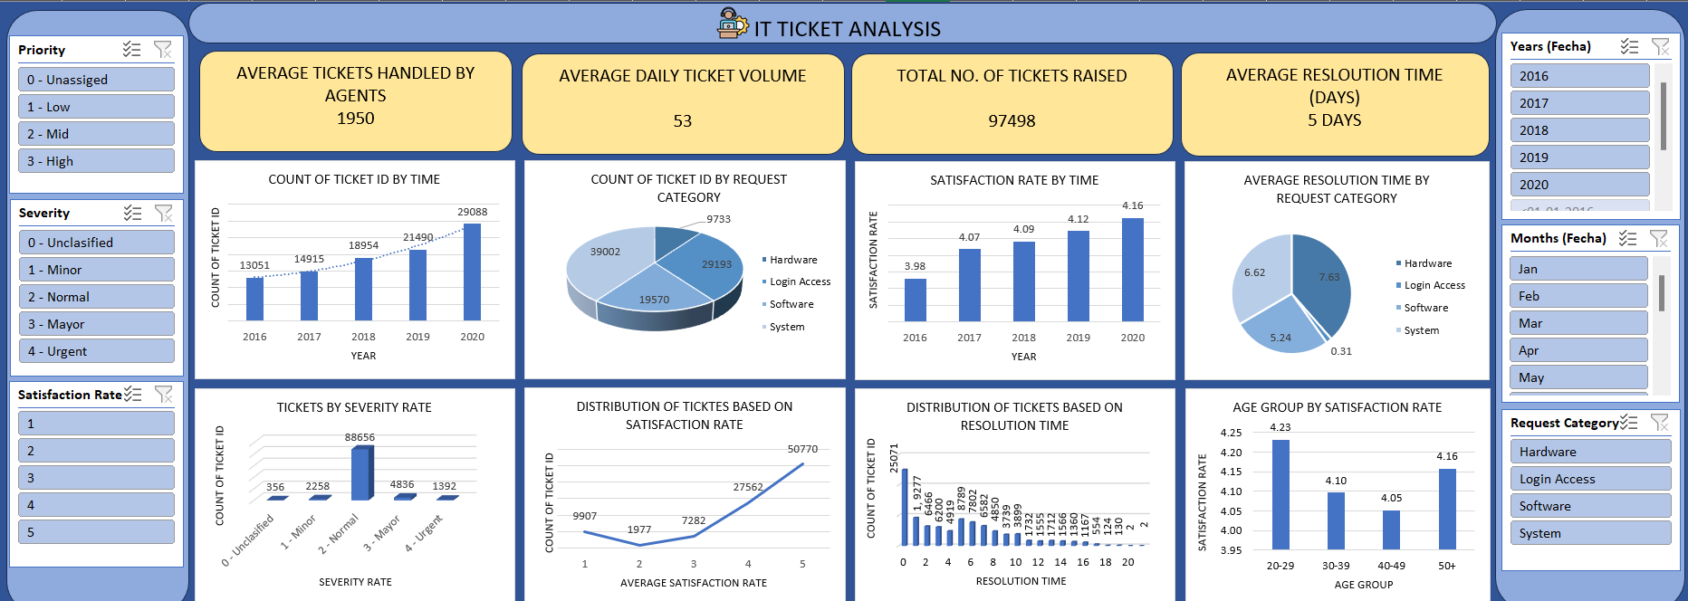
Dashboard

Slide 13
Recommended Action Plan
1. Primary Recommendation:
  Invest in a better Ticket Management Software. The current system is inefficient, especially at handling complex tickets and allowing for automation. A new tool is the foundation for all other improvements.
2. Secondary Recommendations:
  Automate Login Access: Implement a self-service password reset tool to significantly reduce ticket volume.
  Develop Specialized Training: Create training focused on "System" and "Hardware" issues to reduce resolution times for our most complex problems.

Slide 14


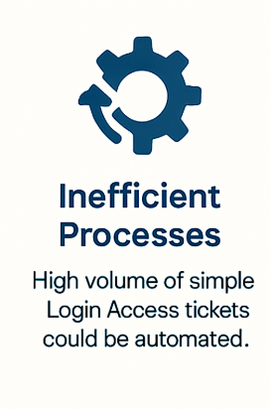
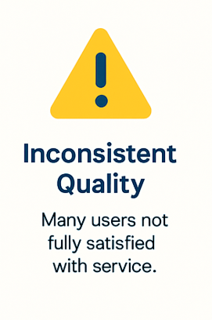
Summary of Key Findings

Slide 15
Conclusion
The help desk is effectively managing a high and growing workload. Despite ticket volume more than doubling over five years, the team maintains a high immediate resolution rate and has consistently improved average satisfaction scores year-over-year.
Service quality is strong but inconsistent. While a majority of users are highly satisfied (rating service a 5 out of 5), a significant number of tickets still receive very low scores, pointing to an opportunity to standardize processes and improve service consistency.
Specific performance bottlenecks are dragging down overall efficiency. Tickets related to Hardware and Login Access take significantly longer to resolve (averaging 6–8 days) compared to other categories, indicating a clear area for process improvement.
User satisfaction varies by demographic and issue type. The highest satisfaction comes from the youngest (20-29) and oldest (50+) employees, while those in the middle age ranges report lower satisfaction, suggesting a need to better tailor support to this core group.

